Slide 1

SmartDent-AI: AI-Driven Diagnosis and Treatment Solutions
Group No. 1
Project Guide
Dr. Vaibhav Yavalkar & Ms. Aishwarya Londhe
Group Member | Moodle ID
Ekta Panchal | 21107049
Aryan Palaspagar | 21107040
Janvi Sharma | 21107032
Swapnil Rathod | 21107064
Notes:
1

Slide 2
Contents
Abstract
Introduction
Objectives
Literature Review
Research Gap
Problem Definition
Scope
Technological Stack
Proposed System Architecture/Working
Prototype Design Demonstration
Implementation Status
Review Suggestions
Notes:
2

Slide 3
Abstract
SmartDent-AI is an advanced AI-powered dental diagnostic and treatment platform aimed at enhancing dental care delivery through accurate diagnostics, personalized treatment planning, and improved patient engagement. By utilizing deep learning models such as MobileNetV2 for disease detection, U-Net for image segmentation, and Pix2Pix for orthodontic treatment simulations, the platform offers comprehensive dental solutions. It accurately detects dental conditions like caries, gingivitis, and misalignment through analysis of dental X-rays and intraoral images. The orthodontic treatment feature uses a Pix2Pix model, consisting of a UNet Generator for aligning misaligned teeth and a PatchGAN Discriminator to ensure realistic image generation. The system preprocesses input images to generate visual representations of aligned teeth, aiding in treatment planning and communication between dentists and patients. SmartDent-AI integrates telemedicine tools for real-time remote consultations, allowing patients to upload images and receive AI-driven diagnostics and personalized treatment recommendations. It also facilitates easy appointment scheduling with specialists. Through its user-friendly interface and real-time processing capabilities, SmartDent-AI provides an innovative and comprehensive solution to revolutionize dental care.
Notes:
3

Slide 4
Introduction
SmartDent-AI enhances dental care by using AI and deep learning to improve diagnosis, treatment planning, and patient engagement. It analyzes X-rays and intraoral images to detect issues like cavities, gingivitis, and misalignment while also supporting orthodontic treatment simulations. The platform enables remote consultations, appointment scheduling, and secure patient record management, making dental care more accurate and efficient,
Motivation
Passion for Innovation: Driven to use AI and cutting-edge tech to improve healthcare and patient outcomes.
Problem-Solving: Motivated by the challenge of creating impactful solutions that enhance dental care accuracy and accessibility.
Real-World Impact: Motivated by the chance to apply AI solutions to solve practical healthcare problems and drive positive change in the dental industry.
Notes:
4

Slide 5
Objectives
To Enhance Diagnostic Precision: Utilize deep learning algorithms, including Convolutional Neural Networks (CNNs), to analyze dental images.
To Generate Orthodontic Treatment Simulations: Implement a deep learning-based approach for aligning misaligned teeth using a structured pipeline. This includes preprocessing images, applying the Pix2Pix model with a UNet-based generator and PatchGAN discriminator.
To Facilitate Remote Consultations: Integrate telemedicine platforms and secure video conferencing tools to consult with dentists remotely, enhancing accessibility and convenience.
To Create Specialist Appointment Scheduling: Develop an integrated booking system that enables patients to schedule appointments with dental specialists based on AI-generated diagnostic reports, utilizing a user-friendly web interface.
To Provide Treatment Suggestions: Ensure that patients receive AI-generated suggestions for further treatment based on diagnostic results, helping them make in-formed decisions about their dental care.
Notes:
5

Slide 6
Literature Review
Sr.no | Title | Author(s) | Year | Methodology | Drawback
1. | Classification of Dental Cavities from X-ray images using Deep CNN algorithm | M. Muthu Lakshmi , Dr. P. Chitra | 2020 | Segmentation Technique, Feature Extraction, Deep CNN Classification | Limited performance in complex cases like overlapping teeth. May not generalize well for other dental diseases beyond cavities
2. | Teeth Detection and Dental Problem Classification in Panoramic X-Ray Images using Deep Learning and Image Processing Techniques | Mircea Paul Muresan, Andrei Rzvan Barbura, Sergiu Nedevschi | 2020 | ERFNet for semantic segmentation, image processing, Tooth Detection, Data Collection | Struggles with overlapping teeth. Computationally expensive, needs optimization
3. | Dental Caries early detection using Convolutional Neural Network for Tele dentistry | Devesh Saini, Richa Jain, Anita Thakur | 2021 | CNN models (Vgg16, Vgg19, InceptionV3, ResNet50) to detect dental caries from 500 images (with and without caries). Preprocessing, | Vgg models were slow and resource-heavy. Limited dataset size (500 images) affects generalizability
4. | CVApool: using null-space of CNN weights for the tooth disease classification | Zuhal Can, Sahin Isik, Yildiray Anagun | 2024 | Used pre-trained CNN models (EfficientNetB1, B2, B3, V2S) with CVApool. | Risk of overfitting in complex models.

Slide 7
Literature Review
Sr.no | Title | Author(s) | Year | Methodology | Drawback
5. | 2D to 3D Evolutionary Deep Convolutional Neural Networks for Medical Image Segmentation | Tahereh Hassanzadeh, Daryl Essam, Ruhul Sarker | 2020 | U-Net architecture, Converts optimized 2D networks, Adapts 2D operations (convolution, pooling) to 3D networks | High computational cost, Limited generalization, time-consuming
6. | A Fully Automated Method for 3D Individual Tooth Identification and Segmentation in Dental CBCT | Tae Jun Jang , Kang Cheol Kim , Hyun Cheol Cho , and Jin Keun Seo | 2022 | Multi-step deep learning model, Teeth detection and segmentation, 3D ROIs (loose and tight) | Metal artifacts impact segmentation accuracy. High-dimensional data poses challenges. Tight ROIs may cut off parts of teeth.
7. | 3D Structure-guided Network for Tooth Alignment in 2D Photograph | Yulong Dou, Lanzhuju Mei,Dinggang Shen, Zhiming Cui | 2023 | Segmentation (Segm-Mod) using U-net. Alignment (Align-Mod) using Diffusion, Generation (Gen-Mod) | Does not account for occlusal relationships. No 3D reconstruction from 2D images, limiting detailed orthodontic applications

Slide 8
Literature Review
Sr.no | Title | Author(s) | Year | Methodology | Drawback
8. | A smart home dental care system: integration of deep learning, image sensors, and mobile controller | Dogun Kim, Jaeho Choi, Sangyoon Ahn, Eunil Park | 2021 | RetinaNet detects teeth regions. ResNeXt classifies tooth diseases and need for professional treatment (NPDT). | Small Dataset, Individual user traits not considered in the model
9. | Automatic Segmentation of Individual Tooth in Dental CBCT Images From Tooth Surface Map by a Multi-Task FCN | Yanlin Chen, Haiyan Du, Zhaoqiang Yun. | 2020 | Two-Branch Fully Convolutional Network (FCN) predicts tooth region and surface probability maps. Thresholding creates a mask to separate foreground (tooth) from background. | Limited Dataset: Only 25 CBCT images were used, limiting generalizability.
10. | Anatomically Constrained Deep Learning for Automating Dental CBCT Segmentation and Lesion Detection | Zhiyang Zheng, Katherine J. Shi, Mel Mupparapu, and Jing Li | 2020 | Dense U-Net, CBCT Segmentation, Lesion Detection, Deep Learning, Dental Imaging, Variational Inference. | Manual Segmentation, Small Dataset, Limited Anatomical Knowledge
11. | Artificial intelligence in medico-dental diagnostics of the face: a narrative review of opportunities and challenges | Raphael Patcas, Michael M. Bornstein | 2022 | Focus on ANN, using deep learning for medical image analysis. | Need for large, diverse datasets, privacy concerns, and a lack of standardized evaluation criteria

Slide 9
Literature Review
Sr.no | Title | Author(s) | Year | Methodology | Drawback
12. | A Review of Machine Learning Methodologies for Dental Disease Detection | Gautam Chitnis, Vidhi Bhanushali, Aayush Ranade | 2020 | CNN and Mask R-CNN for dental disease detection. Transfer learning and fine-tuning | Small datasets limit model performance. Accuracy below clinical standards
13. | UNet Architecture Based Dental Panoramic Image Segmentation | S. Sivagami, P. Chitra, G. Sri Ram Kailash, S.R. Muralidharan | 2020 | Combines contraction and expansion paths with skip connections. | Focuses only on panoramic X-rays.
14. | CariesNet: a deep learning approach for segmentation of multi-stage caries lesion from oral panoramic X-ray image | Haihua Zhu, Zheng Cao, Luya Lian1, Guanchen Ye | 2022 | CariesNet (U-shape network) with full-scale axial attention (FSAA) for caries segmentation. FSAA improves boundary detection for caries lesions. | Difficulty in accurately segmenting moderate caries due to blurred boundaries. Time-consuming data collection and annotation.
15. | Transfer learning: a friendly introduction | Asmaul Hosna, Ethel Merry, Jigmey Gyalmo, Zulfikar Alom | 2022 | Sample selection, domain adaptation, and kernel mean matching. It reuses knowledge from a source task to improve a target task. | Negative transfer can harm performance if tasks/domains are unrelated.2. Sample selection bias may lead to inaccurate models.

Slide 10
Research Gap(Limitations of existing systems)
Inadequate Accuracy: Current systems struggle with accurate prediction of orthodontic treatment outcomes.
Poor Integration: Existing systems often do not integrate well with existing orthodontic workflows.
Manual Segmentation: Existing methods rely heavily on manual segmentation, which is time-consuming.
Inefficient for Complex Structures: Conventional approaches struggle with cases involving complex dental structures, such as overlapping or touching teeth, especially in closed bite conditions.
Limited Automation: Most traditional methods require significant user input and do not provide fully automated, accurate segmentation of individual teeth.
Inadequate for Multiradicular Teeth: Techniques like template-based fitting and graph cut methods show poor performance with multiradicular teeth.
Boundary Blurring Issues: Current systems often fail to clearly distinguish between neighboring teeth due to blurred boundaries, resulting in segmentation inaccuracies.
Notes:
10

Slide 11
Problem Definition
Manual Segmentation Challenges: Current methods for segmenting individual teeth in CBCT images are time-consuming, labor-intensive, and prone to human error.
Blurred Boundaries: Neighboring teeth often have unclear or overlapping boundaries, making segmentation difficult.
Similar Intensities: Teeth and surrounding bone structures have similar intensities, complicating the segmentation process.
Complex Bite Conditions: Segmentation is challenging when teeth are in non-open or closed bite positions.
Artifacts: The presence of metal restorations or other artifacts in images adds complexity to accurate tooth segmentation.
Need for Automation: An AI-based automatic method is required to improve accuracy, efficiency, and consistency in segmenting individual teeth for diagnostic and treatment purposes.

Slide 12
Scope
AI-Driven Diagnostics: Implement deep learning algorithms, including Convolutional Neural Networks (CNNs), to analyze dental images (X-rays, intraoral images, etc) for accurate detection of dental conditions.
Orthodontic Treatment Simulations: Utilize Pix2Pix model and Discriminator to create simulations of orthodontic treatments, enabling visualization of potential outcomes for both patients and dentists.
Personalized Treatment Recommendations: Deploy Recommendation Systems to generate tailored treatment suggestions based on diagnostic data.
Remote Consultations: Integrate telemedicine and secure video conferencing tools to facilitate remote consultations, allowing patients to discuss their diagnostics and treatment options with dentists.
Appointment Scheduling: Develop an integrated booking system that allows patients to schedule appointments with dental specialists based on AI-generated diagnostic reports through a user-friendly interface.

Slide 13
Technological Stack
Frontend
1. HTML5, CSS3, JS, React, NodeJS
Backend & Database
1. Python (Flask)
2. MySQL, Firebase, SQLite
Disease Detection Models
- MobileNetV2: Dental disease detection from images
- DenseNet201 : Pretrained on ImageNet for high-accuracy classification
Image Processing & Alignment Models
- U-Net: Image segmentation for orthodontic simulations
- UNet Generator (Pix2Pix): Aligns misaligned teeth
- PatchGAN Discriminator: Ensures realism of AI-generated orthodontic images
Notes:
13

Slide 14
Technological Stack
Dental Radiography (X-ray Dataset)
1. Train (1076 images)
2. Test (74 images)
3. Validation (122 images)
Oral Disease Dataset
1. Calculus (1296 images)
2. Gingivitis (2349 images)
3. Data Caries (1251 images)
4. Mouth Ulcer (1303 images)
5. Tooth Discoloration (1500 images)
Misaligned to Aligned Teeth Dataset
1. Misaligned Teeth (300 images)
2. Aligned Teeth (300 images)
Notes:
14

Slide 15
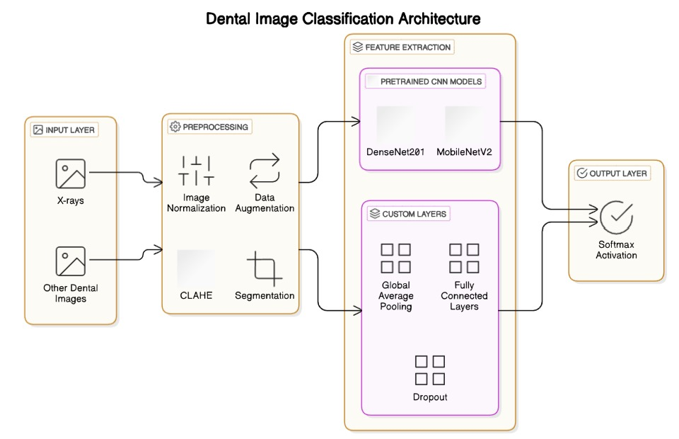
Dental Disease Detection & Diagnosis Architecture
Notes:
15

Slide 16
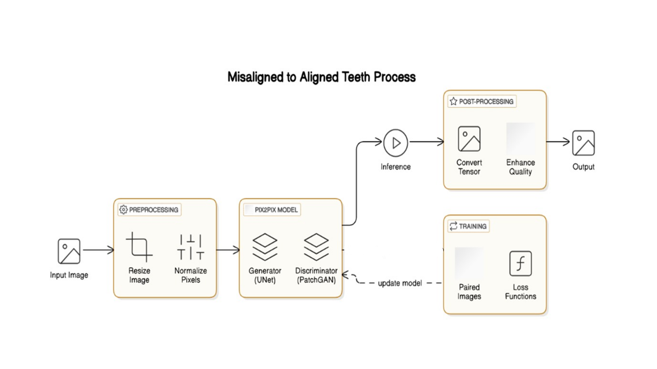
Orthodontic Treatment Simulation Architecture
Notes:
16

Slide 17
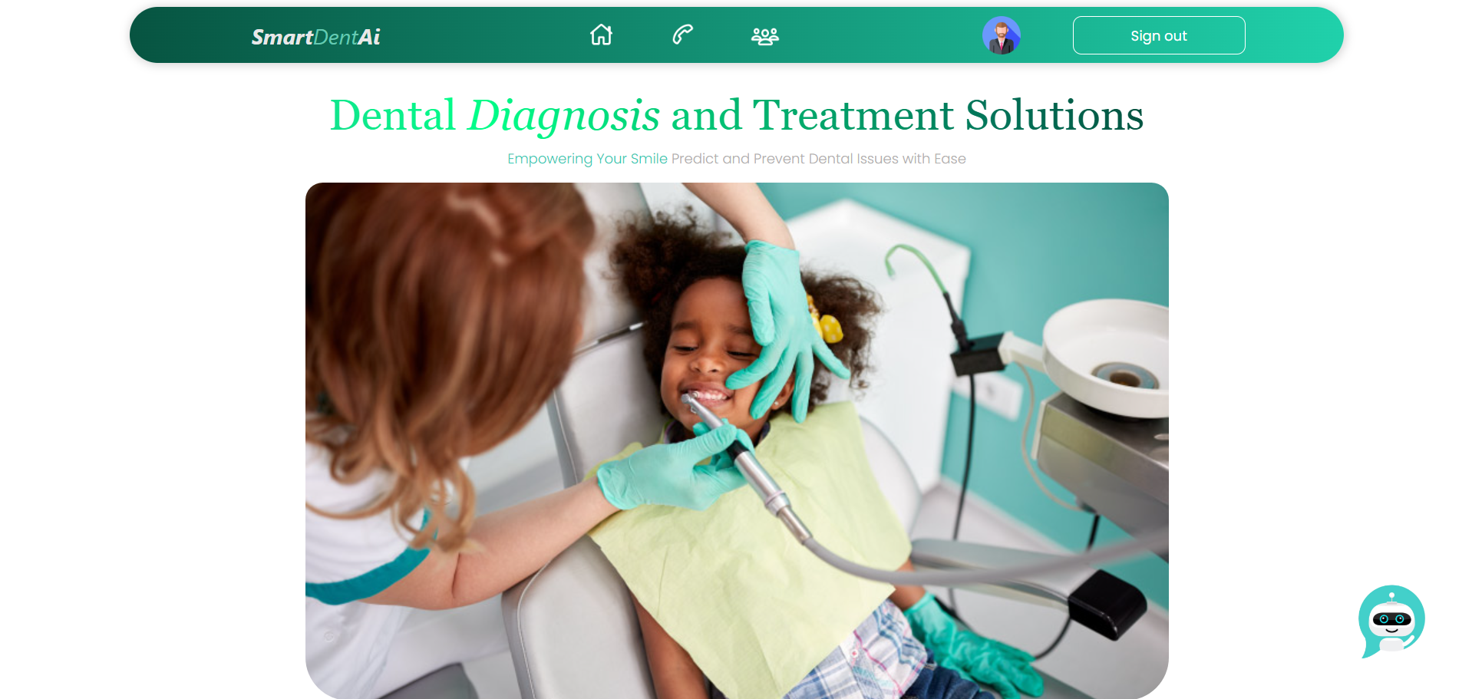
Implementation status

Slide 18
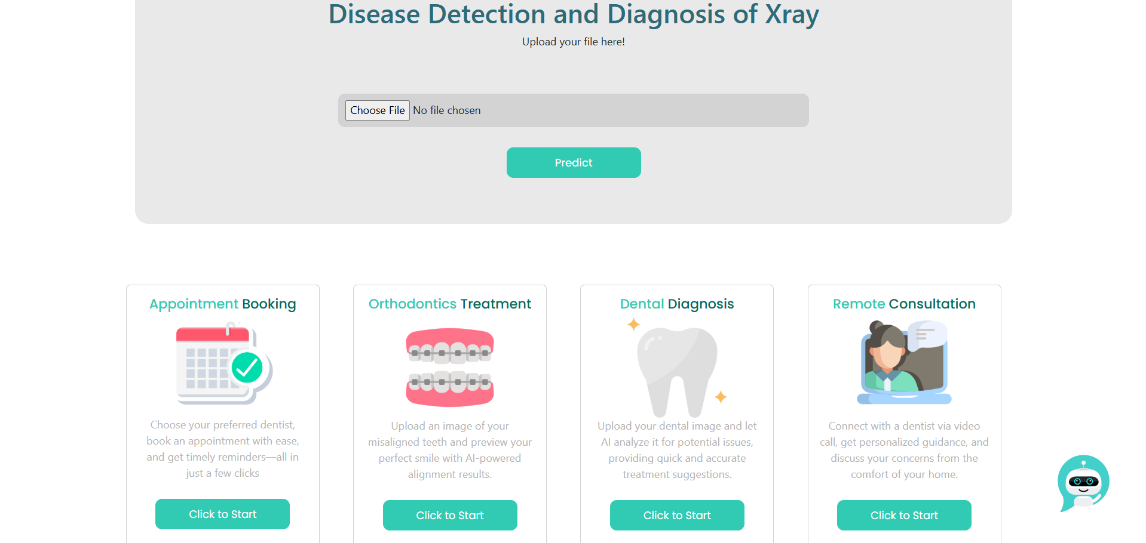

Slide 19
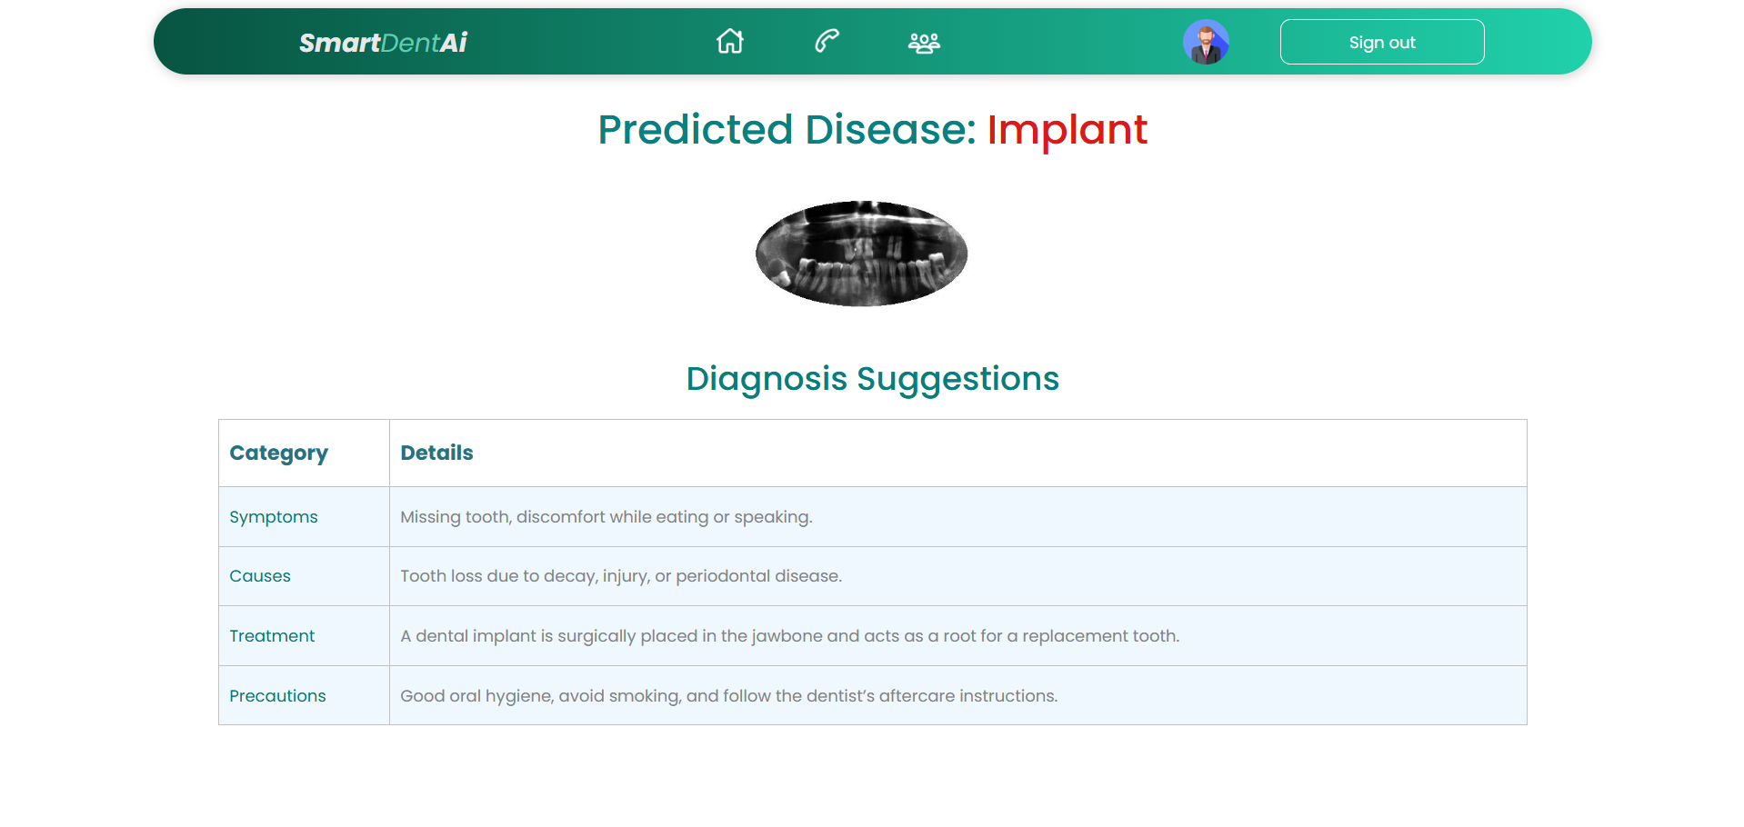

Slide 20
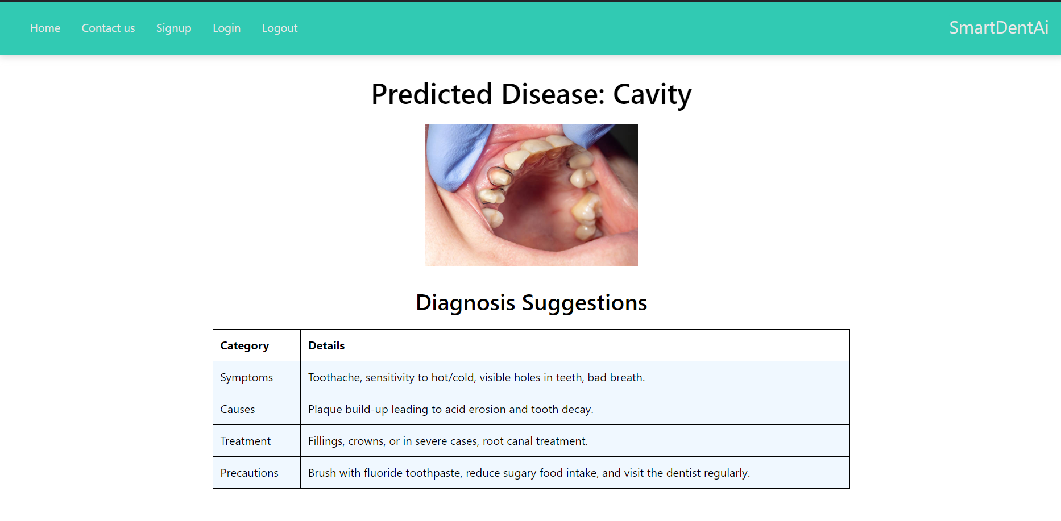

Slide 21
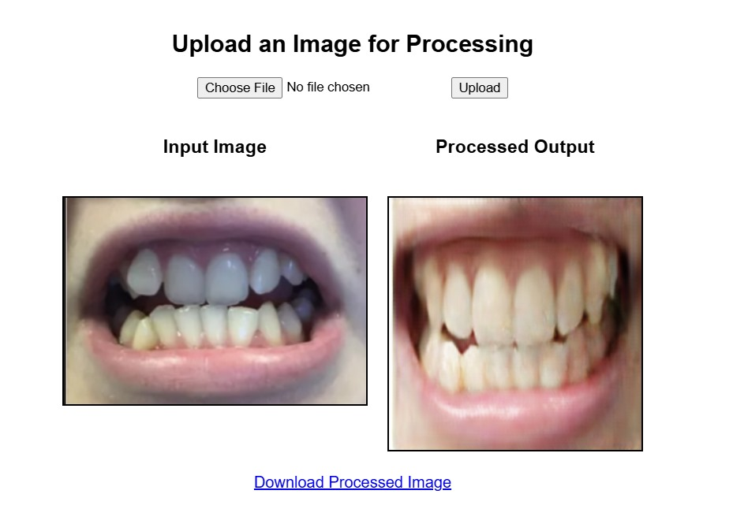

Slide 22
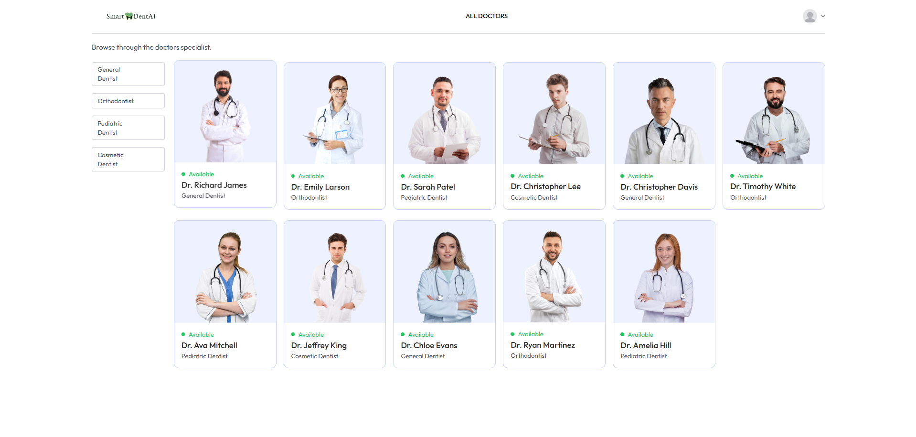

Slide 23
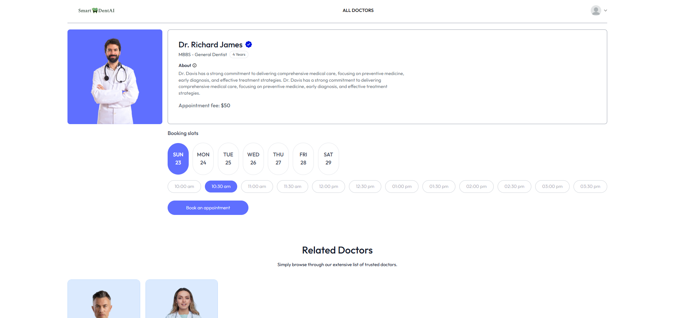

Slide 24
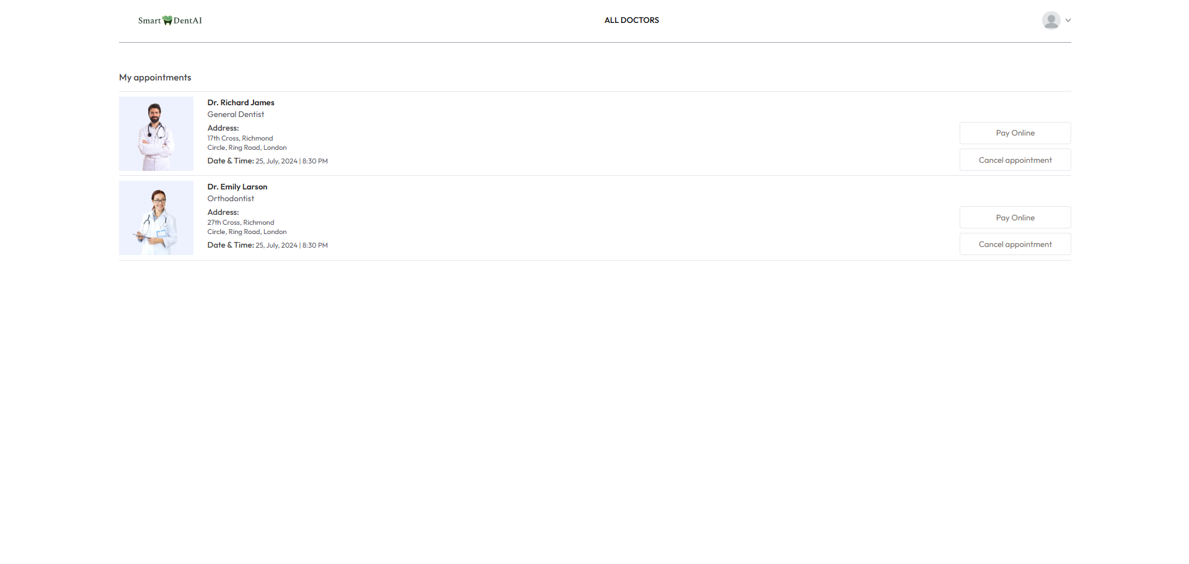

Slide 25
References
[1] Asmaul Hosna, Ethel Merry, Jigmey Gyalmo, Zulfikar Alom, Zeyar Aung, Mohammad Abdul Azim, "Transfer learning: a friendly introduction," Journal of Big Data, Pages 1-19, 2024.
https://journalofbigdata.springeropen.com/articles/10.1186/s40537-022-00652-w
[2] Haihua Zhu, Zheng Cao, Luya Lian, Guanchen Ye, Honghao Gao, Jian Wu, "CariesNet: a deep learning approach for segmentation of multi-stage caries lesion from oral panoramic X-ray image," Neural Computing and Applications, Volume 35, Pages 16051–16059, 2023.
https://link.springer.com/article/10.1007/s00521-021-06684-2
[3]​ S. Sivagami, P. Chitra, G. Sri Ram Kailash, S.R. Muralidharan, "UNet Architecture Based Dental Panoramic Image Segmentation," WiSPNET Conference Proceedings, Pages 187-191, 2020​.
https://ieeexplore.ieee.org/document/9198370
[4] Zhiyang Zheng, Hao Yan, Frank C. Setzer, Katherine J. Shi, Mel Mupparapu, Jing Li, "Anatomically Constrained Deep Learning for Automating Dental CBCT Segmentation and Lesion Detection," IEEE Transactions on Automation Science and Engineering, Pages 1-20, 2020​.
https://ieeexplore.ieee.org/document/9219218
Notes:
25

Slide 26
References
[5] Gautam Chitnis, Tejasvini Khadase, Vidhi Bhanushali, Vaishnavi Pelagade, Aayush Ranade, Jitendra Chavan, "A Review of Machine Learning Methodologies for Dental Disease Detection," IEEE India Council International Subsections Conference (INDISCON), Pages 1-10, 2020​.
https://ieeexplore.ieee.org/abstract/document/9344564
[6] Lawrence Y. Deng, See Sang Ho, Xiang Yann Lim, "Diseases Classification Utilizing Tooth X-ray Images Based on Convolutional Neural Network," 2020 International Symposium on Computer, Consumer and Control (IS3C), Pages 1-5, 2020​.
https://ieeexplore.ieee.org/document/9394023
[7] Dogun Kim, Jaeho Choi, Sangyoon Ahn, Eunil Park, "A smart home dental care system: integration of deep learning, image sensors, and mobile controller," Journal of Ambient Intelligence and Humanized Computing, Volume 12, Pages 1-17, 2021.
https://link.springer.com/article/10.1007/s12652-021-03366-8
[8] Raphael Patcas, Michael M. Bornstein, Marc A. Schätzle, Radu Timofte, "Artificial intelligence in medico-dental diagnostics of the face: a narrative review of opportunities and challenges," Clinical Oral Investigations, Volume 26, Pages 6871-6879, 2022.
https://pubmed.ncbi.nlm.nih.gov/36153437
Notes:
26

Slide 27
Thank You...!!
Notes:
27

